Slide 1
Big Data - Lecture 1
ATLS-4214 / ATLS-5214
Course Overview
Lecture 01

Slide 2
“Education is what remains after one has forgotten what one has learned in school.”
― Albert Einstein

Slide 3
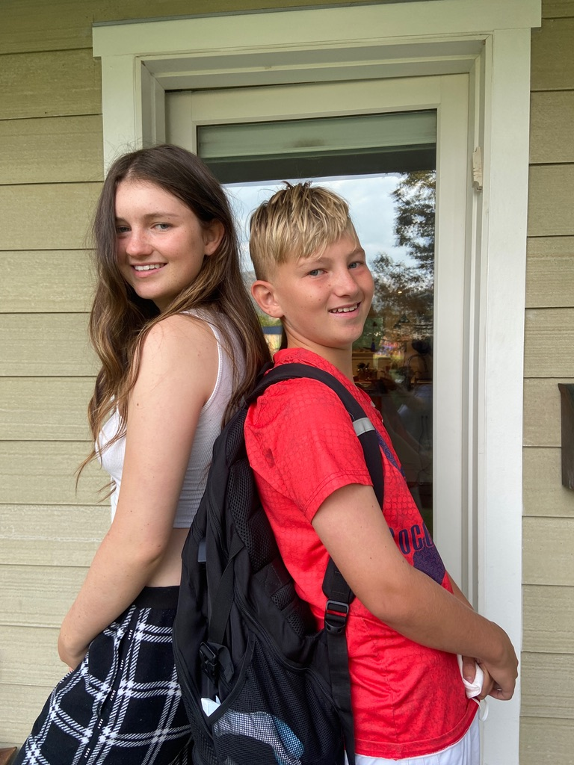
Who am I?
Married & father of 12 & 15 year old (& a fat cat)
VP of Engineering - Splunk - Site Lead Boulder
Adjunct Professor @ CU - Big Data Architecture
CU Computer Science Advisory Board Member
Mentor @ TechStars
Past companies
Twitter - Director of Engineering / Site Lead Boulder
GNIP (exit to Twitter) - VP Eng
Collective Intellect (exit to Oracle) - CTO
CreekPath (exit to OpsWare/HP) - Staff Eng
DigitalGlobe (IPO) - Architect
6 startups & 4 larger companies
MS in Computer Science from CU in 1992
30+ years of commercial software experience

Slide 4
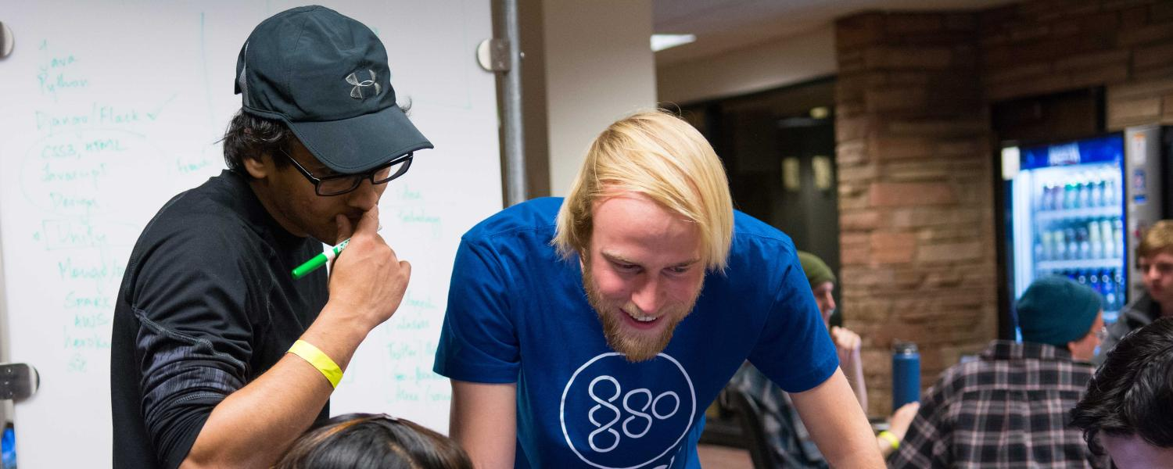
My trusty TA… Brian Newsom
Met Brian when he won the Twitter HackCU competition.
Hired him at Twitter.
He has gone on to great success and position at Twitter Boulder….
https://www.linkedin.com/in/briannewsom/
<brian.newsom@colorado.edu>
@RealBrianNewsom

Slide 5
Goals
Provide experiential learning using real world tools
Skills I see missing in graduates….
Bring in Guest Lecturers that are experts in their domain
Create a map of technology you can use to solve problems
Toolset
Cloud computing (GCP or AWS)
Git/GitHub (Source Control)
Pivotal (Agile Project Mgmt)
Google Apps (Lectures/Presentations)
Twitter (Announcements)
Definition of Big Data
Brief history of data growth and technology advancements
Datafication of our world, Correlation vs. Causality, Value

Slide 6
Goals cont..
Storage
Relational vs. NoSQL
Origins - Big Table (Google) / Dynamo (Amazon)
Survey of NoSQL stores & how to choose
Cloud options
Processing
Batch vs. Streaming
Concurrency - going wide
Open Source frameworks (e.g. Hadoop, Spark, Flnk, etc.)
Distributed Architecture (Queueing, Search, Web Services, etc.)
Analytics
Machine Learning, Statistical Methods,, NLP, etc. (Tensor Flow)
Performance
Visualization / Data Science
Prepare you for the real world

Slide 7
Toolset
Twitter (announcements)
You need a Twitter account (www.twitter.com)
follow - https://twitter.com/BigDataCU
GoogleApps (notes, lectures, etc.)
Getting this setup - using your existing colorado.edu gmail
GitHub (source control)
https://github.com/organizations/CUBigDataClass
Pivotal (Agile Process)
https://www.pivotaltracker.com/
Getting accounts setup with Pivotal.
GCP or AWS (Cloud Computing Resources)
https://cloud.google.com/ http://aws.amazon.com/

Slide 8
Format
Semester Long Project - 60% of grade
Choose your own programming languages/frameworks
Small groups (4-5)
Mix of skills
Graded upon process & participation
Result do matter, but only part of grade
Don’t put off project until end of semester!
Ongoing lectures on various topics
Guest Lecturers
Quizzes on Lecture Material - 40% of grade
Expect consistent effort week in/out instead of cramming for tests/completing project the night before it is due, etc.

Slide 9
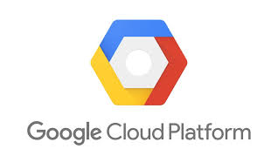

Hardware
Use your own laptops for development.
Deploy on a cloud platform (you are responsible for getting student account and pooling credits)

Slide 10
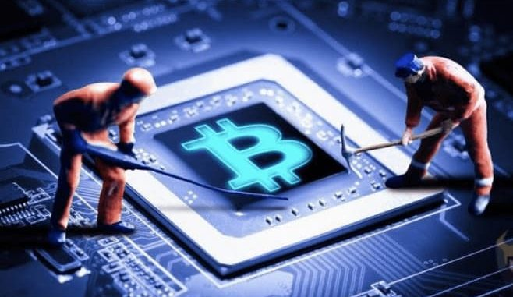
#1 Mistake every semester
NEVER CHECK-IN YOUR AWS CREDS INTO A PUBLIC REPOSITORY!!!

Slide 11
What is Big Data?
Examples:
2009 - Google able to predict spread of H1N1 virus better than CDC
processed 450 million models against past data to find 45 search terms that predicted spread of virus
Oren Etzioni founded Farecast to predict whether airline tickets prices would go up or down (http://homes.cs.washington.edu/~etzioni/)
crunched 200 billion flight-price records
by 2012 system made correct call 75% of the time / $50 ticket
Microsoft bought for $110 M and integrated into Bing
Gnip
Took entire firehose from Twitter, Tumblr, Disqus, FourSquare, etc.
Serves 6B social media activities/day in 42 countries

Slide 12
How Big is Big?
2000 - Sloan Digital Sky Survey Telescope amassed more data in its first few weeks than than the entire history of astronomy. (140 TB/2010)
Its successor the Large Synoptic Telescope in Chile collects that amount every 5 days
2003 - Human genome took a decade of intensive work to sequence the 3B base pairs
Today a single facility can sequence than much DNA in a day
In US equity markets, 7B shares change hands every day
⅔ of trades are automated trades based on models
Google processes more than 24 Petabytes / day
1000’s of times more data than all US Library of Congress material
Twitter grows 200% / year, now over 500M tweets/day

Slide 13
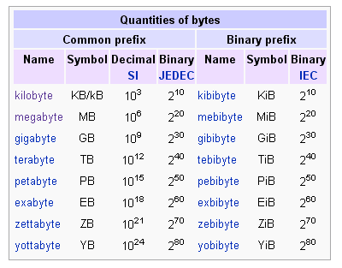

Size

Slide 14
How Much Data Exists?
Martin Hilbert (http://www.martinhilbert.net/WorldInfoCapacity.html)
Everything produced, stored, & communicated
2000 - only 1/4 of stored data was digital
other ¾ was paper, film, LPs, magnetic cassettes, etc.
2007 - 300 Exabytes stored data
Only 7% of data was analog
2013 - 1200 Exabytes of stored data
98% is digital
if in printed books would cover US 52 layers thick
on CD’s would form 5 piles to the moon
equivalent to every person on earth having 320x the information contained in the Library of Alexandria

Slide 15
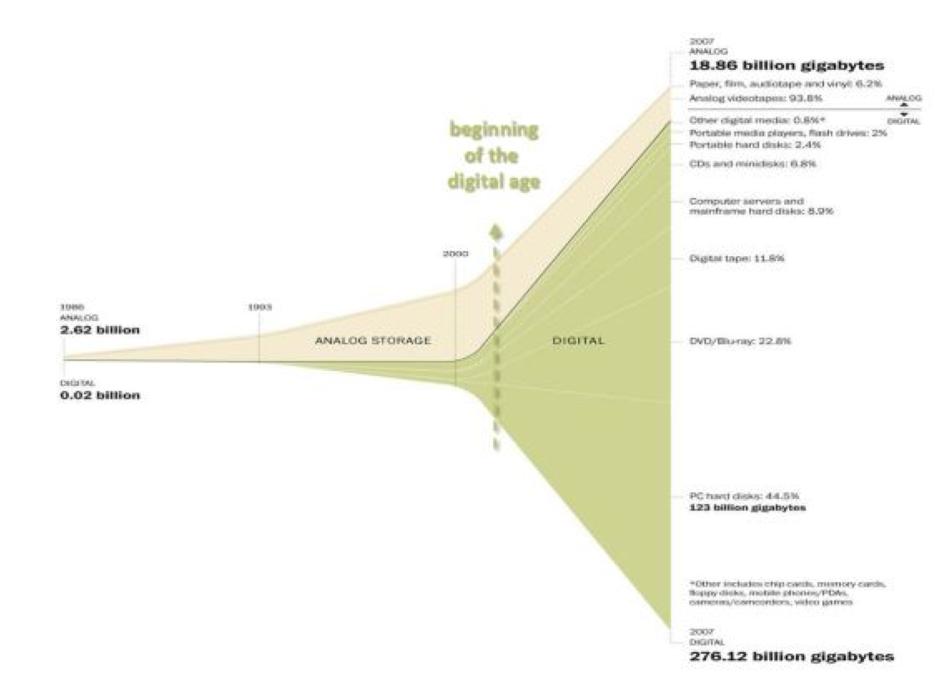
The Digital Age...

Slide 16
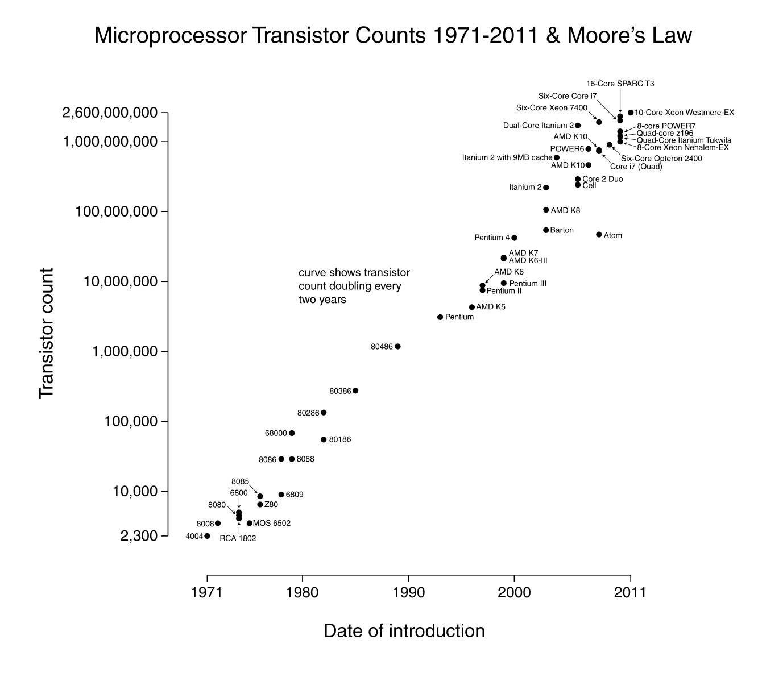
Processing Power

Slide 17
but…
‘…in about ten years or so, we will see the collapse of Moore’s Law. In fact, already, already we see a slowing down of Moore’s Law. Computer power simply cannot maintain its rapid exponential rise using standard silicon technology. Intel Corporation has admitted this.’
“So there is an ultimate limit set by the laws of thermodynamics and set by the laws of quantum mechanics as to how much computing power you can do with silicon,” says Kaku, noting “That’s the reason why the age of silicon will eventually come to a close,” and arguing that Moore’s Law could “flatten out completely” by 2022.
Read more: The Collapse of Moore's Law: Physicist Says It's Already Happening | TIME.com http://techland.time.com/2012/05/01/the-collapse-of-moores-law-physicist-says-its-already-happening/#ixzz2qD6peJPK
chip makers are now going wide with more cores on each chips
more cores = more threads
concurrency in software is now crucial

Slide 18
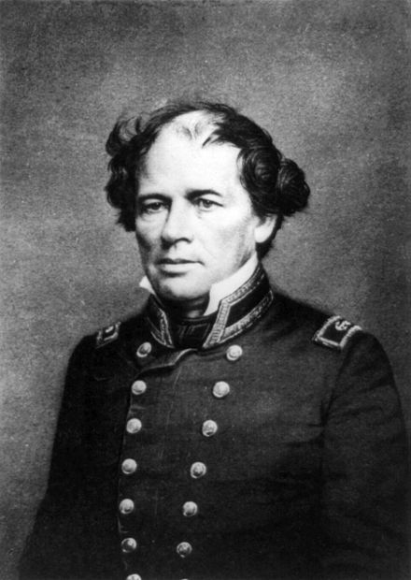
Datafication
Matthew Fontaine Maury (January 14, 1806 – February 1, 1873), United States Navy, was an American astronomer, historian, oceanographer, meteorologist, cartographer, author, geologist, and educator.
Injured in a stagecoach accident on his way to serve on the Consort
Ended up in a desk, Head of the Depot of Charts and Instruments
Mined crates full of old Captain’s log books from previous voyages
Used his dozen “computers” to extract and tabulate the data
Divided up data into 5 degree long/lat blocks
Noted temperature, speed & direction of winds, waves, and month
Created standard form for logs on all ships
From his data, natural sea lanes presented themselves
Cut long voyages by ⅓
1855 published his magisterial work - The Physical Geography of the Sea
had plotted 1.2 M data points
His work was essential for laying the first transatlantic telegraph cable
At the dawn of the 21st century, pilot charts issued by the US Navy still bore his name

Slide 19
Modern Examples
Google scanned and indexed 20M book titles (~15%) of written: https://books.google.com/ngrams text
You can search terms/time at
Location
GPS - Based on satellite data opened to non military use (1980s)
Smart phones collect and send back data based on wifi networks,etc.
Social Media
Facebook’s Social Graph
Twitter real-time feed of what is happening in the world
Fitbit
Track sleep and exercise habits
RFID
A chip inside the new Cyber Tyre transmits info on road conditions and friction coefficients to the car's computer.

Slide 20
Correlation vs. Causality
Humanity has had to rely on theories and hypothesis to date
Hypothesis were tested on sample data (often biased)
Being able to collect process N=ALL allows us to focus on What not Why
What is often enough, and may actually suggest theories/hypothesis
Sample data doesn’t allow drill down into subgroups
How Target Figured Out A Teen Girl Was Pregnant Before Her Father Did
http://www.forbes.com/sites/kashmirhill/2012/02/16/how-target-figured-out-a-teen-girl-was-pregnant-before-her-father-did/

Slide 21
Target
“My daughter got this in the mail!” he said. “She’s still in high school, and you’re sending her coupons for baby clothes and cribs? Are you trying to encourage her to get pregnant?”
The manager didn’t have any idea what the man was talking about. He looked at the mailer. Sure enough, it was addressed to the man’s daughter and contained advertisements for maternity clothing, nursery furniture and pictures of smiling infants. The manager apologized and then called a few days later to apologize again.
On the phone, though, the father was somewhat abashed. “I had a talk with my daughter,” he said. “It turns out there’s been some activities in my house I haven’t been completely aware of. She’s due in August. I owe you an apology.”
Duhigg suggests that Target’s gangbusters revenue growth — $44 billion in 2002, when Pole was hired, to $67 billion in 2010 — is attributable to Pole’s helping the retail giant corner the baby-on-board market

Slide 22
Value
2000 - 22 yr. old Luis von Ahn invents Captcha to combat spambots
ReCaptcha followed, operating on real words text recognition algorithms couldn’t recognize - saves $1B/year
Today ⅓ of all Amazon sales are generated by its recommendation systems
Walmart, the largest retailer in the world at 450 B/year (a sum greater than the GDP of ⅘ of the world’s countries), uses its RetailLink system to force suppliers to take care of stockage themselves, effectively becoming a huge consignment shop.
Data can be used over and over again for purposes not even imagined when it was collected.
The companies who control the data have an advantage in the new economy

Slide 23
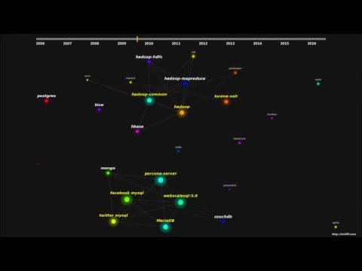
Open source map visualization

Slide 24
Things to do...
Git
http://gitready.com/
http://www.vogella.com/tutorials/Git/article.html
use Google - a thousand more….
Github
https://github.com/
I have created a private Github organization “CUBigDataClass”
If you don’t have a GitHub account Id’s, please create one
Project Groups
Self selection of groups (over the next few weeks)
Organize based on common interest and tech skills/stack (get diverse skill sets front/back end)

Slide 25
You will get out of this course what you put into it...
I will treat you like adults
I will share all lectures with you via Google Docs
I expect consistent effort & professionalism
It is easy to tell from Pivotal and Github who puts in the work
Please help create a respectful and fun environment for your fellow students
Don’t underestimate the quizzes - they often make the difference in grades.
I will bring experts from industry from many companies - most will be looking for new graduates.
This course is about you trying new things - so don’t be afraid to fail and bang your head against the wall a few times.
Pick a project that interests you - the more you enjoy something, the better job you will do.

Slide 26
Boulder has more software jobs per capita than SF
I will do what I can do to help you find internships and jobs locally…
Public Companies w/ local presence:
Oracle (bought Sun Microsystems, Collective Intellect, and many more)
Google (bought SketchUp originally in Boulder)
Twitter (bought GNIP)
Splunk (bought VictorOps) - Big Data Analytics
Carbon Black - Security Threat Detection - bought by VM Ware
NetApp (bought Solid Fire) - Storage
Pandora (recently bought by Sirius FM)
Slack (opening new office in Denver)
Zayo - Fiber Optic Networking
Twillio (just purchased SendGrid)
Amazon (Ads play downtown)
Uber (soon to be public)

Slide 27
Questions?
contact info:
gregory.greenstreet@colorado.edu (non-urgent)
gregory.greenstreet@gmail.com (i need attention now!)
@ggreenstreet (personal Twitter)
@BigDataCU (general announcements for class)
TA - Brian Newsom <brian.newsom@colorado.edu>
@RealBrianNewsom (Brian’s personal Twitter)

